Slide 1
Outline
Introduction
Theory
Software

Slide 2
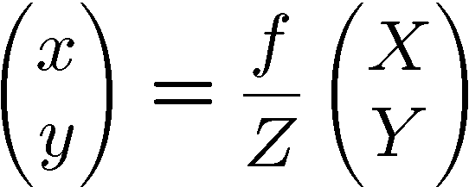
Pinhole Camera Model
Z
object point (X, Y, Z)^{T}
image point (x, y)^{T}
x
y
f: focal length
camera’s
optical center
O
X
Y
f
Z
O
x
X
X-Y-Z: camera coordinate frame
x-y: (normalized) image coordinate frame

Slide 3
Pixel Coordinates
Z
u
x
v
y
O
X
Y
u-v: image coordinate (pixel coordinate) frame

Slide 4
Camera Intrinsic Matrix
3x3 camera intrinsic matrix

Slide 5
Coordinate Transformation of the Object Point
Say, the object point coordinates are expressed in a different coordinate frame X’-Y’-Z’
R: 3x3 rotation matrix
t: 3D translation vector

Slide 6
Camera Projection Matrix
3x4 camera projection matrix

Slide 7
Homography Matrix (1/2)
Assume the object point is on a plane and its coordinates are (X’, Y’, 0) without loss of generality.
Z
object point (X', Y', 0)^{T}
image point (x, y)^{T}
x
y
camera’s
optical center
O
X
Y
3x3 homography matrix

Slide 8
Homography Matrix (2/2)
When the homography matrix is given, the mapping from/to (X’, Y’) and (u, v) are uniquely determined
  The scale factor Z is determined from the 3rd row eqn.
  Then the other rows eqns are solved
When n (>= 4) known points on a plane are observed by a camera, H can be computed

Slide 9
Summary so far
If you have four or more corresponding points between the screen and the camera image, homography matrix between them can be computed
Once homography matrix is obtained, any point coordinates can be transformed from screen to camera, and vice versa
H

Slide 10
Homography Between Two Views (1/2)
Think of two cameras observing a point on a plane
camera 1
camera 2

Slide 11
Homography Between Two Views (1/2)
3x3 homography matrix that gives mapping between
the pixel coordinates of camera 1 / camera 2
When n (>= 4) corresponding points on a plane are observed by the two cameras, H = H₂H₁⁻¹ can be computed
Once H is obtained, the mapping from/to camera 1 and camera 2 pixel coordinates is straightforward
One of the camera can be a projector

Slide 12
So, what to do is...
(Prepare a contents image in the camera image coordinate frame)
Find homography between projector and camera
Transform (warp) the contents image to the projector image
Then, the projected image will look as if the camera is a handheld projector
H

Slide 13
Transitive Application of Homography Matrices
H₁
H₂
H₁H₂

Slide 14
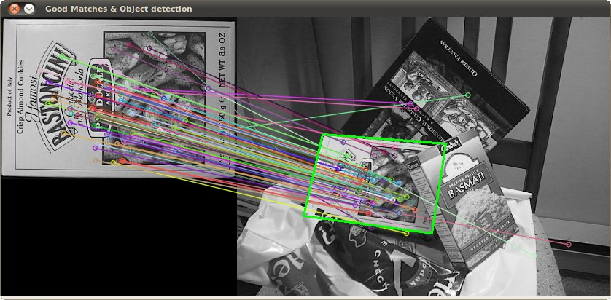
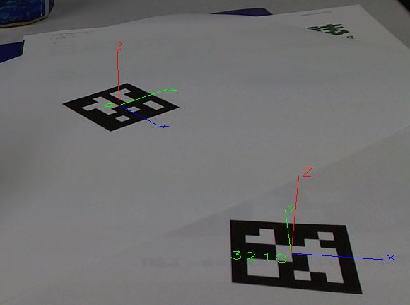
Corresponding Points Problem
In principle, because we know what kind of image we display from the projector, making correspondence between the points in the projector image and those in the camera image
But how to do it practically?
  Local image feature descriptors (Image keypoints)
  Fiducial markers

Slide 15
Outline
Introduction
Theory
Software

Slide 16
Software Building Blocks
C/C++ Environments
  e.g. Microsoft Visual Studio
    (Express edition is free of charge!)
Computer Vision in General
  OpenCV (Python bindings are also available)
    keypoints (SIFT, SURF, ORB, ...)
    Homography estimation
    Image warping
Fiducial Markers
  ARToolKitPlus (independent on OpenCV)
  ArUco (implemented using OpenCV)

Slide 17
OpenCV
Official Site
  http://opencv.org/
A short introduction (with setup info) is available at:
  http://www.ic.is.tohoku.ac.jp/~swk/lecture/#ic

Slide 18
ARToolKitPlus
Official Site
  http://handheldar.icg.tugraz.at/artoolkitplus.php
Unfortunately they have stopped development, and the newest codes cannot be compiled recent Visual C++
So, setup the modified version in the USB memory
  Open build/VC8.XP/ARToolKitPlus.sln
  Specify configuration you want (e.g. x64/Release)
  Build only ARToolKitPlus project with
When used, in VC++ setting:
  Library path: add {ARToolKitFolder}/lib/Win32 (or lib/x64 if you choose x64)
  Include path: add {ARToolKitFolder}/include
  additional dependency: ARToolKitPlus.lib (or ARToolKitPlusd.lib if you choose Debug config.)

Slide 19
ArUco
Official Site
  http://www.uco.es/investiga/grupos/ava/node/26
You need CMake to build it in Visual Studio
  http://www.cmake.org/
Setup:
  Run cmake-gui and set source to {arucoFolder} and build to {arucoFolder}/build, and then configure.
  Set OpenCV_DIR to {OpenCVfolder}/build, uncheck BUILD_SHARED_LIBS, and then generate.
  Open build/aruco.sln and build.
When used, in VC++ setup:
  Library path: add {arucoFolder}/build/bin/Release (or build/bin/Debug if you choose)
  Include path: add {arucoFolder}/src
  additional dependency: aruco***.lib (*** is version name)

Slide 20
Sample Code (1) - OpenCV
simple_capture
  displays images captured by USB camera
keypoints_homography
  estimates homography between two images using ORB keypoints
  requires also:
    opencv_calib3d***.lib
    opencv_features2d***.lib

Slide 21
Sample Code (2) – ARToolKitPlus & OpenCV
artoolkitplus_homography_warp
  finds four AR markers in USB camera image and overlays an image from a file onto it
  requires also:
    opencv_calib3d***.lib
  Put lena.jpg in the upper directory
  Put camera_param.cal and marker_config.cfg in the same directory (the contents can be dummy)

Slide 22
Sample Code (3) – OpenCV & ArUco
aruco_homography_warp
  finds four AR markers in USB camera image and overlays an image from a file onto it
  requires also:
    opencv_calib3d***.lib
    aruco***.lib
  Put lena.jpg in the upper directory
aruco_create_marker
  generates ArUco marker image (say, id = 100, 128x128 pixels) by the following command:
    aruco_create_marker.exe 100 output.png 128
  requires also:
    aruco***.lib

Slide 23
Sample Code (4) – Misc.
fullscreen
  displays an image in full screen mode (Windows only)
  Put lena.jpg in the upper directory

Slide 24
Python Install – OpenCV 3 pre-built for Windows
Install python 2.x or 3.x
  https://www.python.org/downloads/
Windows (pre-built binaries)
  Install pip:
  http://stackoverflow.com/questions/4750806/how-do-i-install-pip-on-windows
  Pre-built binaries (openCV 2.4 & 3.1, python 2.7 & 3.4-3.5): http://www.lfd.uci.edu/~gohlke/pythonlibs/#opencv
  Run in cmd or powershell:
  pip install [filename_of_pre-built_binares]
  Open python IDLE, write these lines to check that it works:
  import cv2
  print(cv2.__version__) # in python 3.x
  # print cv2.__version__ in python 2.x

Slide 25
Python Install – OpenCV 3 for OSX and Ubuntu
OSX (for Python 3.4 or 2.7)
  http://www.pyimagesearch.com/2015/06/29/install-opencv-3-0-and-python-3-4-on-osx/
  http://www.pyimagesearch.com/2015/06/15/install-opencv-3-0-and-python-2-7-on-osx/
Ubuntu (for Python 3.4 or 2.7)
  http://www.pyimagesearch.com/2015/07/20/install-opencv-3-0-and-python-3-4-on-ubuntu/
  http://www.pyimagesearch.com/2015/06/22/install-opencv-3-0-and-python-2-7-on-ubuntu/

Slide 26
Sample Code for python with OpenCV 3
Inside folder python_sample
  background_demo.py – shows an image
  camcapture_demo.py – shows captured webcam frames

